Slide 1


Find My Spot
A Real Time Parking Allocation System
By
KISHAN KATHIRIYA CHINTAN TIKEKAR
PRATIKKUMAR GOHIL
Project Supervisor
MIN CHAN

Slide 2
Objective
The purpose of this project is to search a nearest available parking spots while entering to the campus as people spend around 10 to 15 min searching available parking spot to park their vehicle.

Slide 3
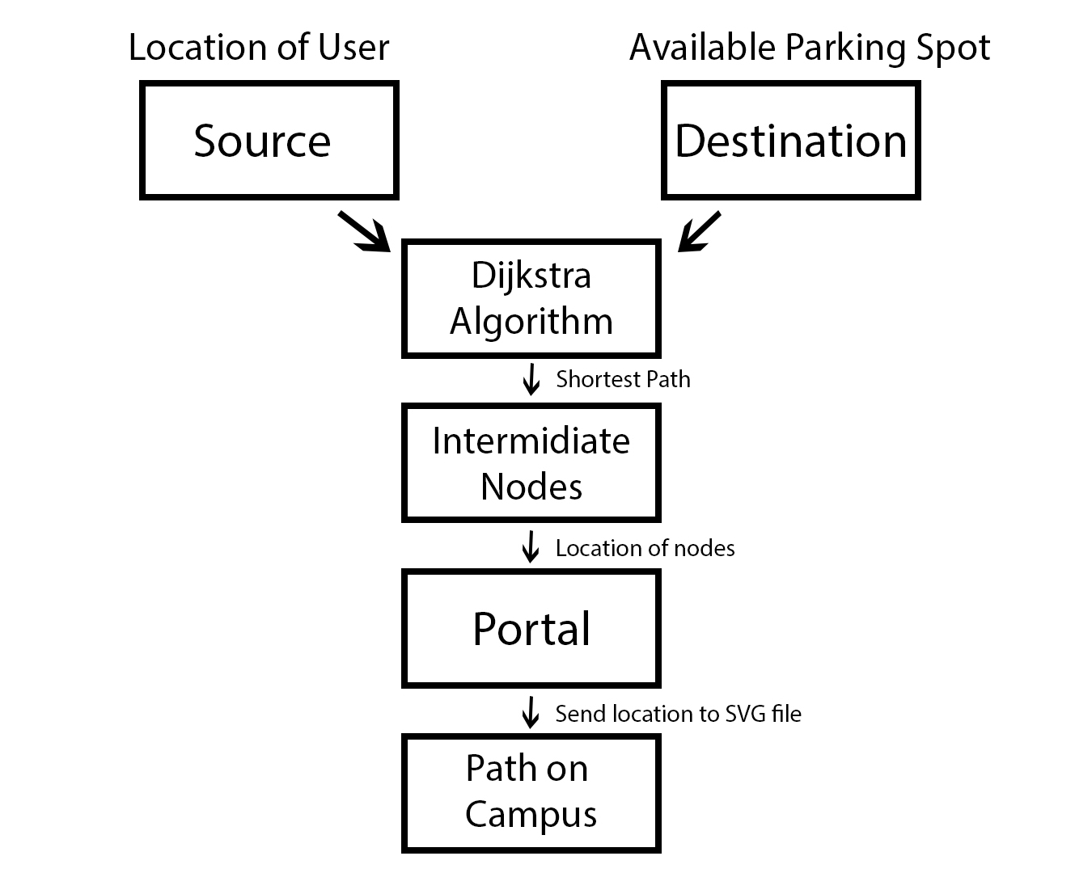
Work Flow

Slide 4
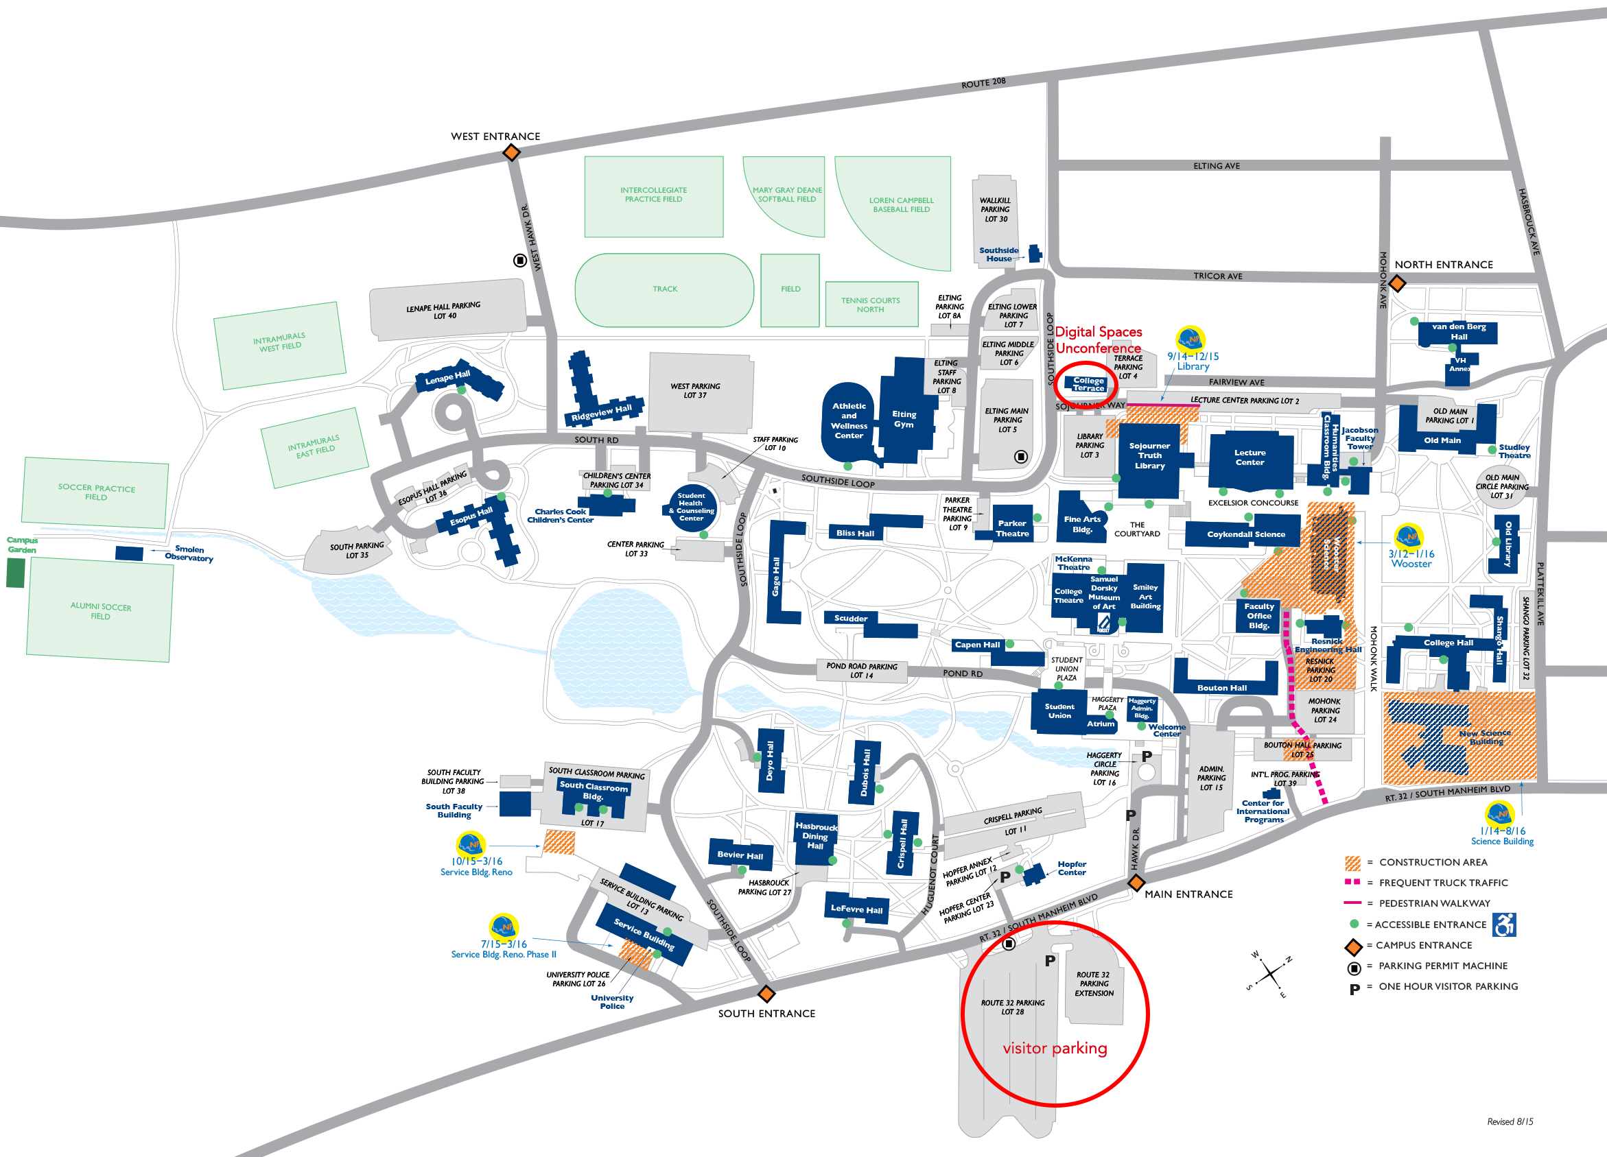
Approach of Study
SUNY NEW PALTZ MAP

Slide 5
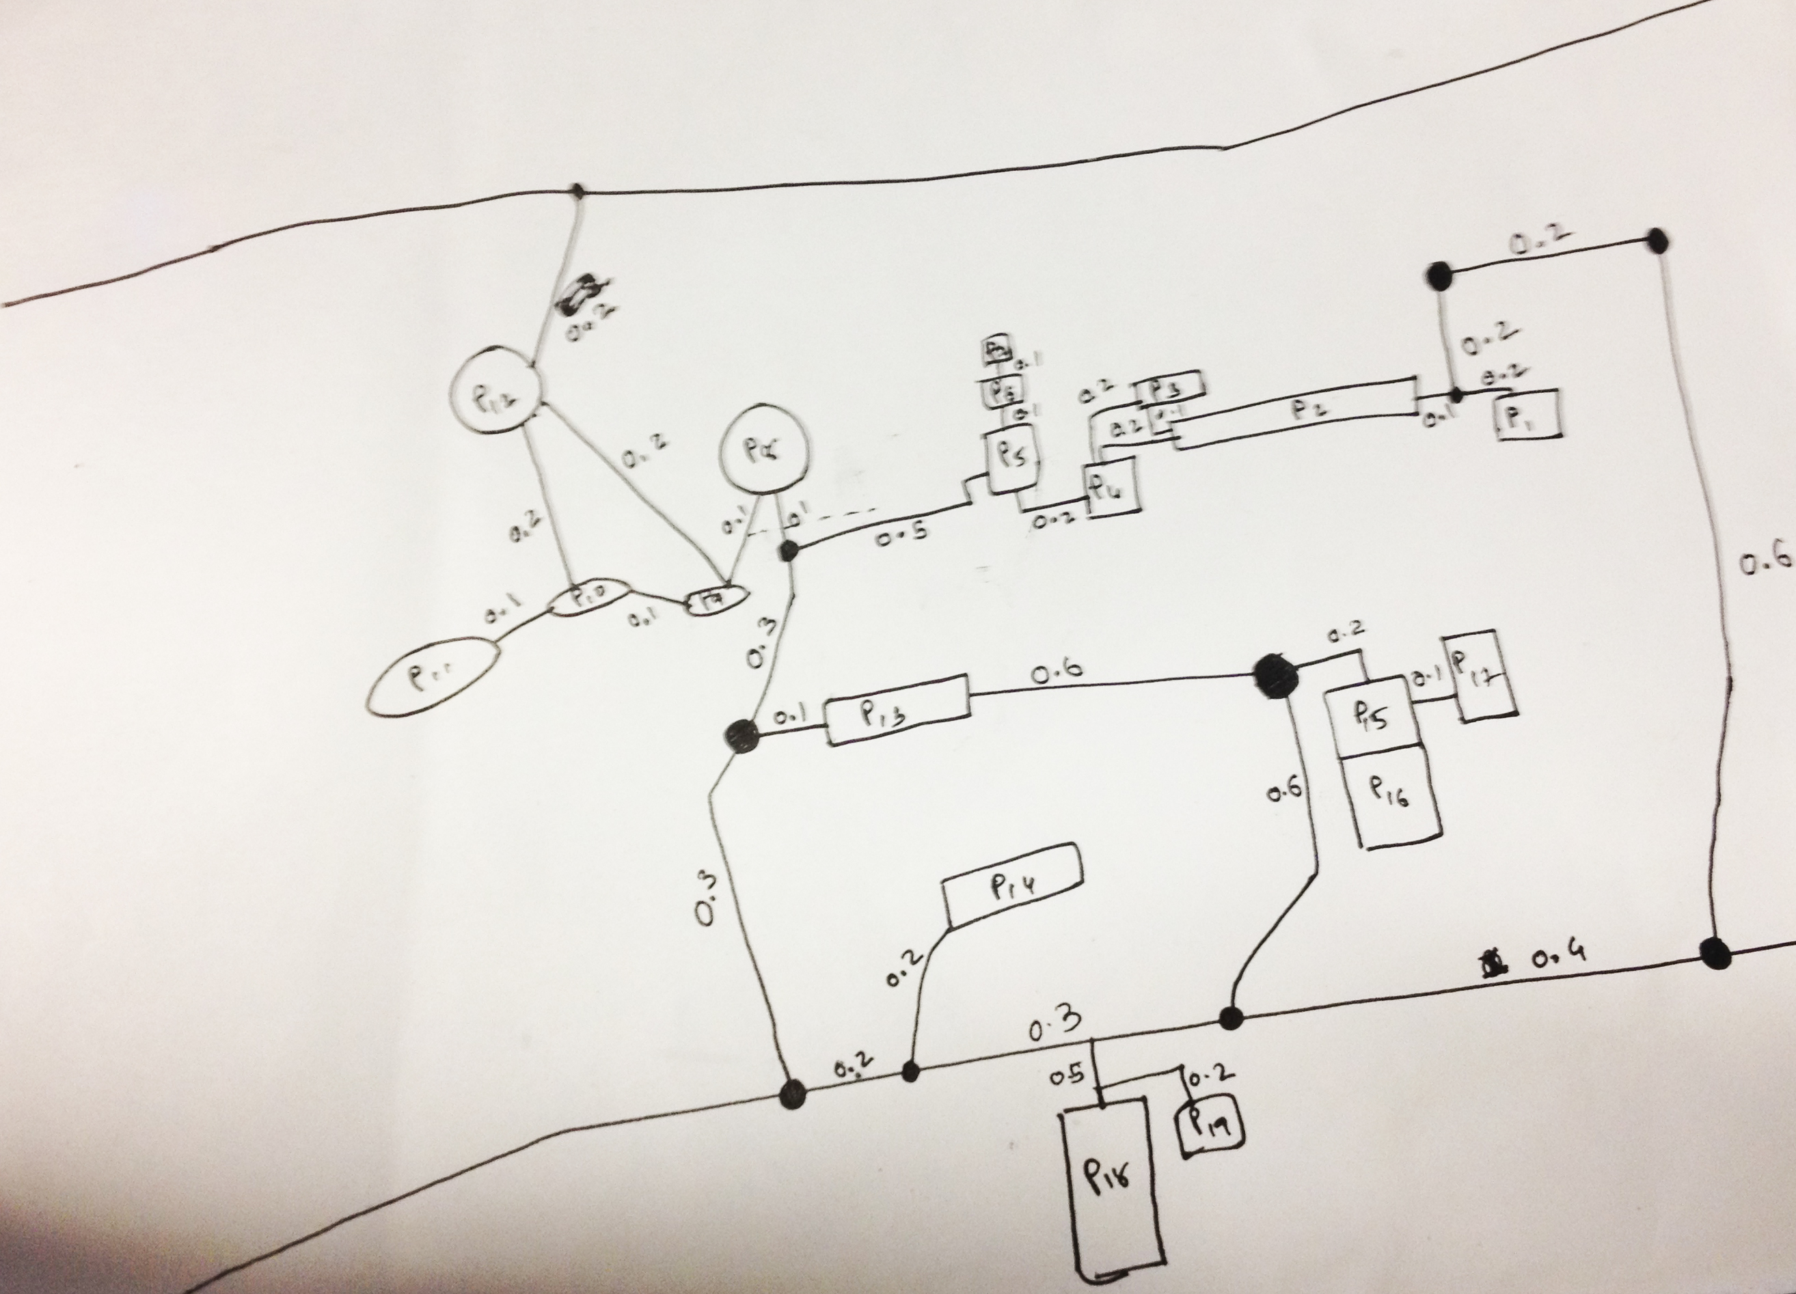
Graph Implementation
SUNY NEW PALTZ MAP in GRAPH FORM

Slide 6
Java Implementation
Graph Creation in Backend:
Vertex.java
Edge.java
Graph.java
Graph Creation in Frontend:
Scalable Vector Graphic(.svg) file to represent Map

Slide 7
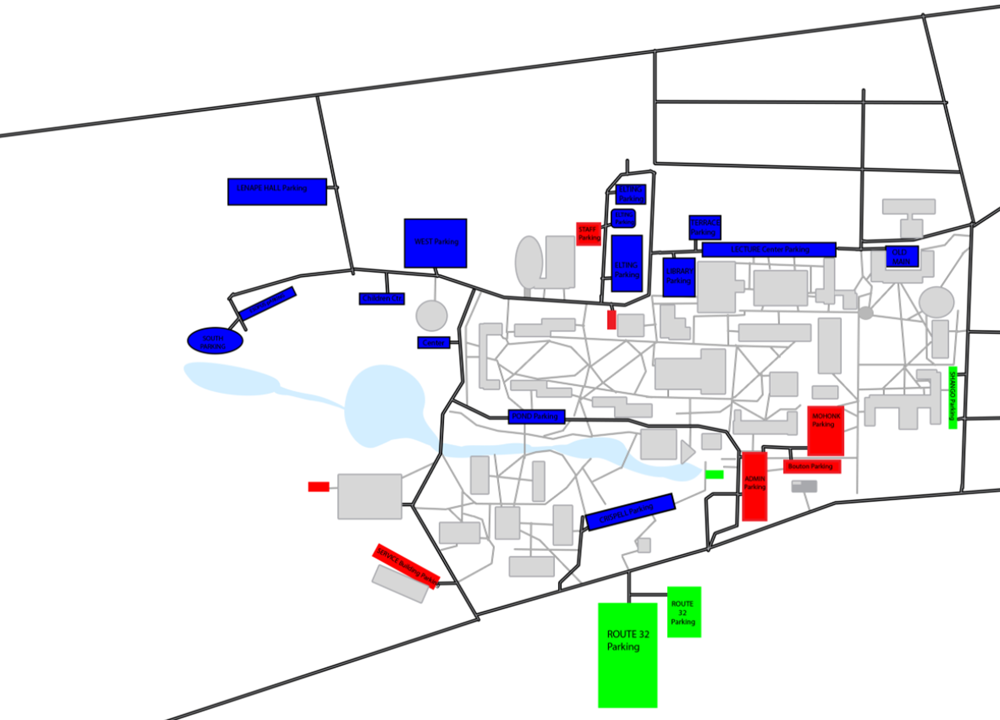
SVG Implementation
SUNY NEW PALTZ MAP in SVG Format

Slide 8
What is Dijkstra
Dijktra’s algorithm is an algorithm for finding the shortest paths between nodes.
It uses matrix representation to relate nodes and edges.
Algorithm generates distance matrix using source node.
Then it will find shortest path.

Slide 9
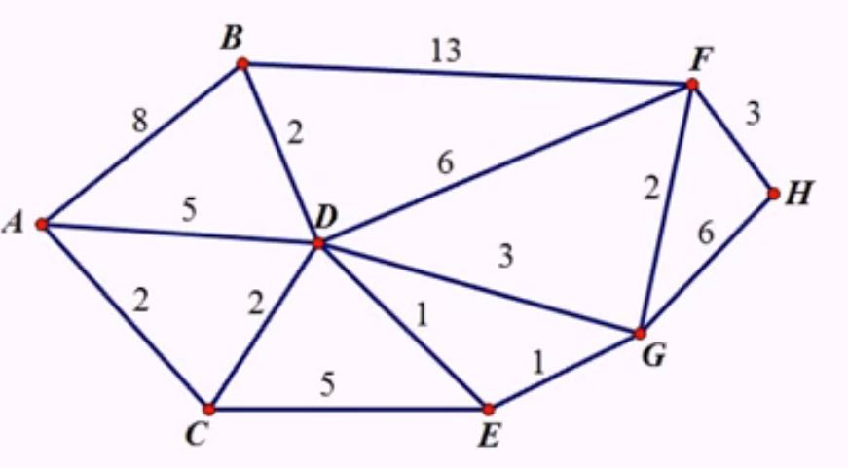
Example of Dijkstra’s algorithm
V A B C D E F G H
A
0A
8A
2A
5A
∞
∞
∞
∞
C
8A
2A
4C
7C
∞
∞
∞
D
6D
4C
5D
10D
7D
∞
E
6D
5D
10D
6E
∞
B
6D
10D
6E
∞
G
8G
6E
12G
F
8G
11F
H
11F
Shortest from source A to H is :
A C D E G F

Slide 10
Campus Graph

Slide 11
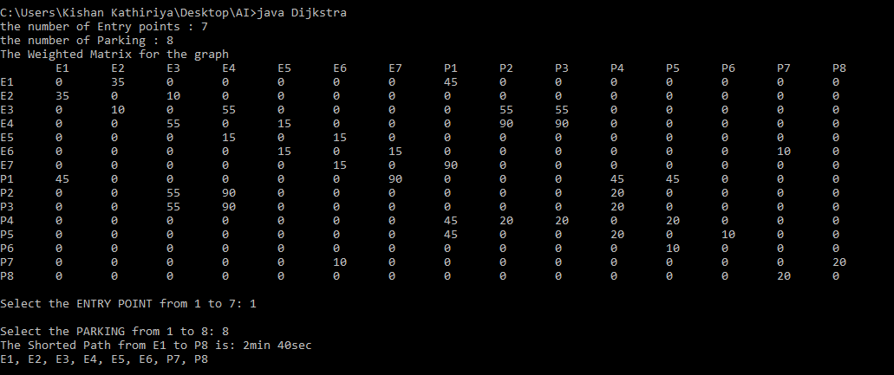
Dijkstra Matrix Of Campus and Output

Slide 12
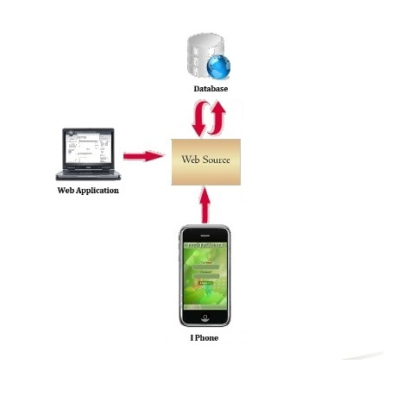
System Architecture

Slide 13
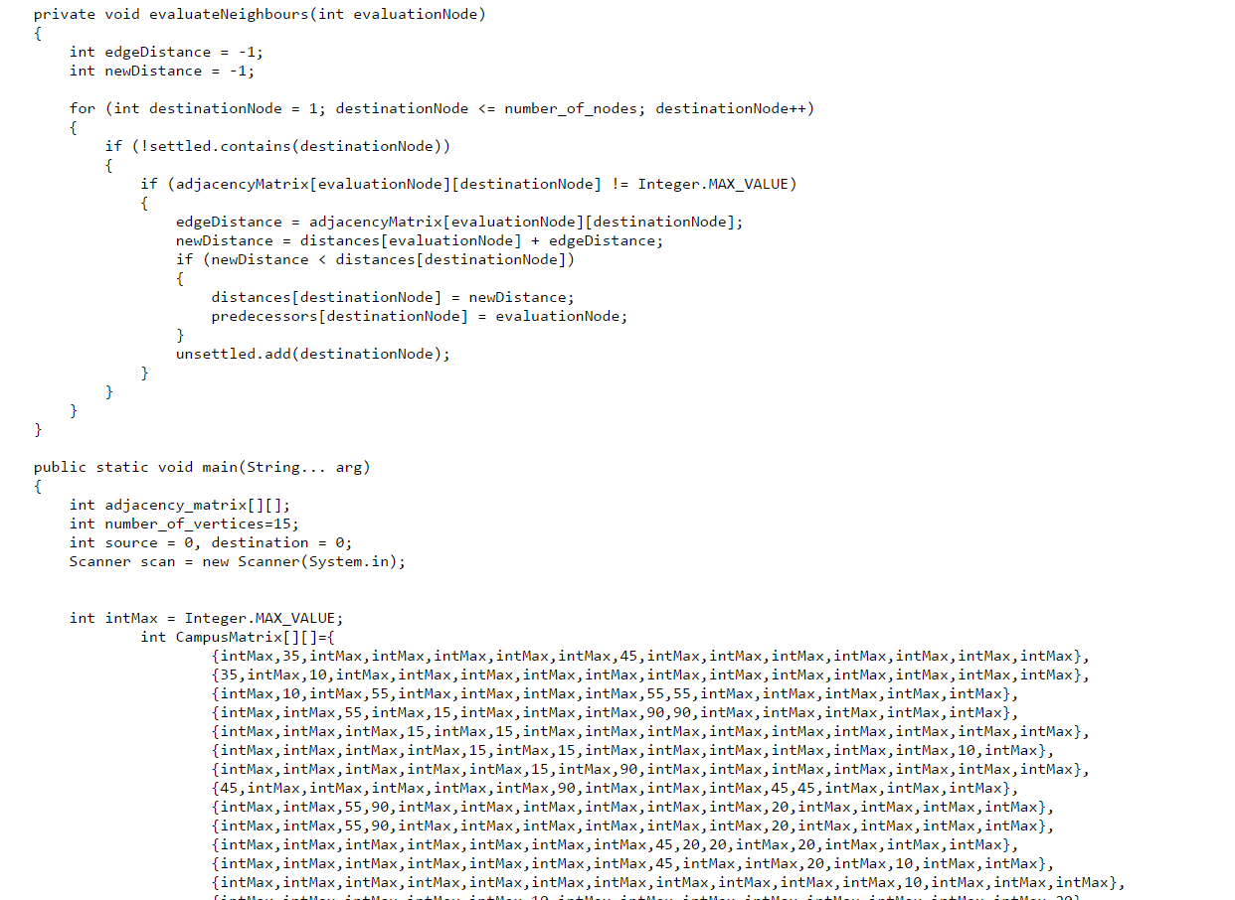
Sample of Code

Slide 14
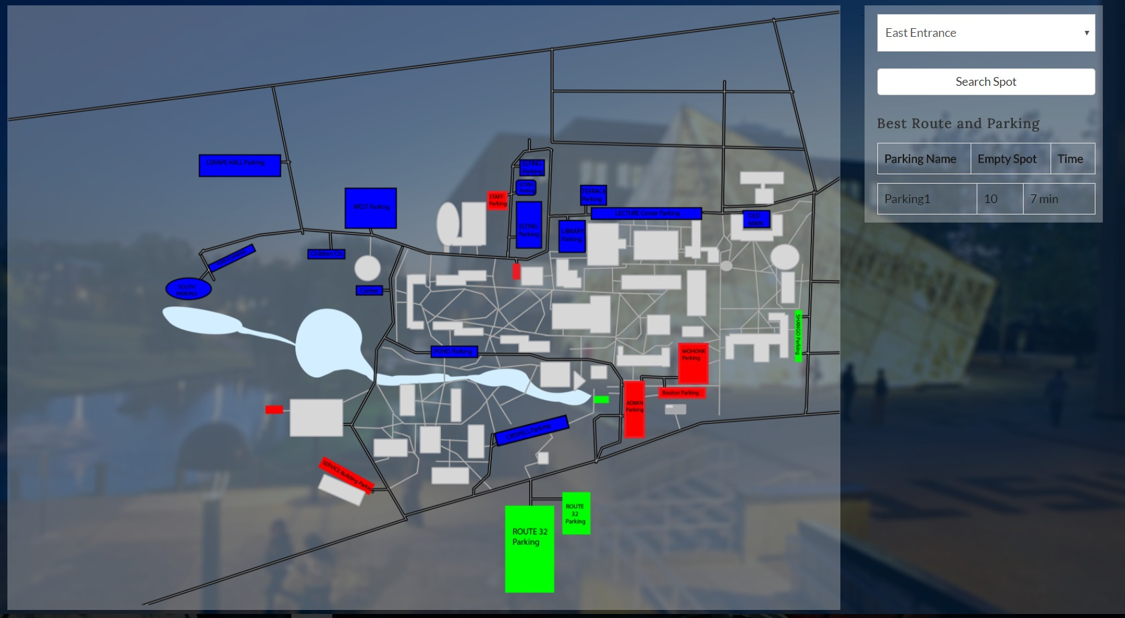
How It Works
Screenshot

Slide 15
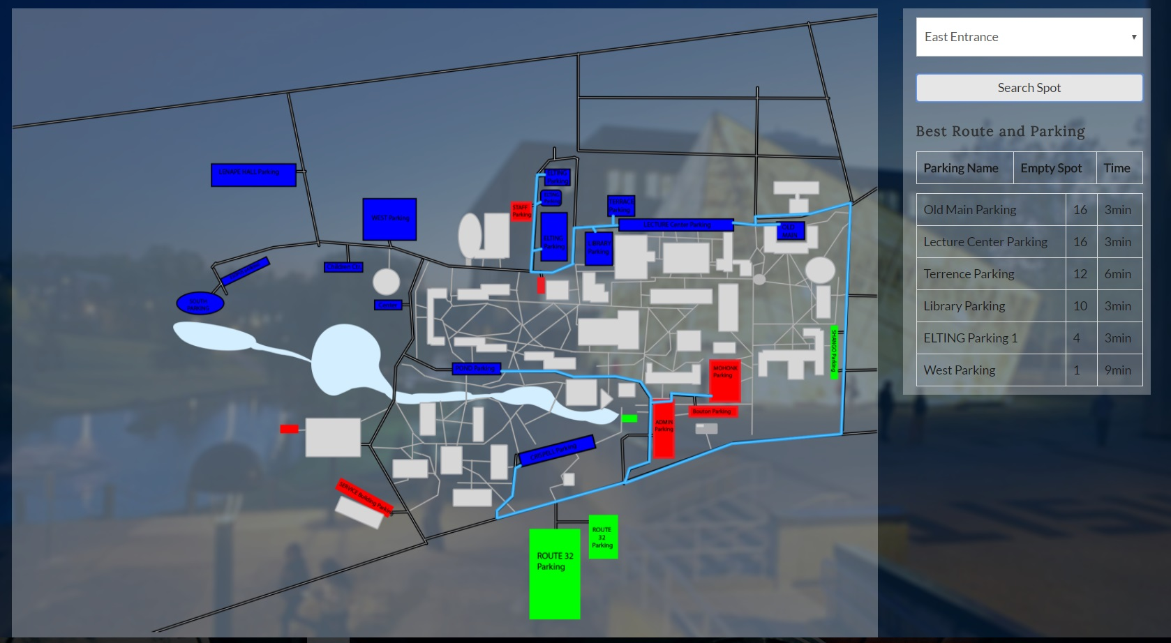
How It Works
Screenshot

Slide 16
Scope:
This project can be a prototype for the real world enterprise application using Sensors for parking spots and GPS locations
Sensors: To detect a parking spot if available or not and updating this information dynamically to the database
GPS: To get the user location and to get the path to the desired parking spot.
Also GPS will be used for navigation.
Database: Database will be used for various reasons like updating the availability of the parking spots, saving the user location, etc

Slide 17
Scope:
User
GPS Location
Request
Available Spot
Dynamic Parking Availability Database
Update
Availability
Parking Spots Sensors
Web Portal
Get
Available Spot
Dijkstra’s Algorithm
Output Map With
the Path and Navigation

Slide 18
Questions?
137.140.216.6:8080/FindMySpot1/index.jsp

Slide 19
Thank you

